Slide 1
Git’n Pro with HTML/CSS

Slide 2
It’s Okay!
How do I do this again?
Flickr: welcometolearn
Notes:
After Monday… by a show of hands, how many people feel like I understand anything I talked about?

Slide 3
Admin Items

Slide 4
Where to Get Help
Practice, Practice, Practice: Work Individually or in Groups
Review In Class Material (Exercises and Slides): See GitLab
Re-Watch Class Videos: See GitLab
In Class Office Hours: 45 minutes before class, 30 minutes after
One-on-One Sessions: By Announcement through SSM
Contact Student Success: Anytime!
Notes:
Give an overview of Git Lab
You can also use slack

Slide 5
Homework #1 - Assignment
Also, at this point everyone should have access to the homework repository in GitHub. https://cw.bootcampcontent.com/
Homework Assignment #1 is due next week
Next Wednesday (4/25/2018)
Notes:
We will go over tonight what homework looks like. It should be uploaded to bootcamp spot. Details are located in GitLab

Slide 6
Today’s Class!

Slide 7
Today’s Objectives
Students will understand the importance of Git Version Control and of how to use it.
Students will create GitHub Repositories, push code into them, and share with class.
Students will make more HTML documents.
Students will learn to properly use basic HTML tags.
Students will implement basic CSS styling to HTML documents.
Notes:
Have a student(s) help read this

Slide 8
Know Thyself
If you are a complete beginner to HTML/CSS and Coding:
Continue getting comfortable with HTML.
Be able to completely write a basic HTML document (like in last class).
Understand what CSS is, what it’s for, and how it works with HTML.
Be able to use Git and GitHub to upload code.
If you’ve had past exposure and felt comfortable with the last lesson:
Aim to build up your skills. Clear up any questions or confusions about HTML.
Become knowledgeable about a wider range of HTML and CSS tags.
Be able to selectively apply CSS to specific HTML elements.
Be able to use Git and GitHub to upload code.

Slide 9
What / Why Git?
Notes:
So what is Git? Has anyone in class ever used get before? [ask to explain what Git is]

Slide 10
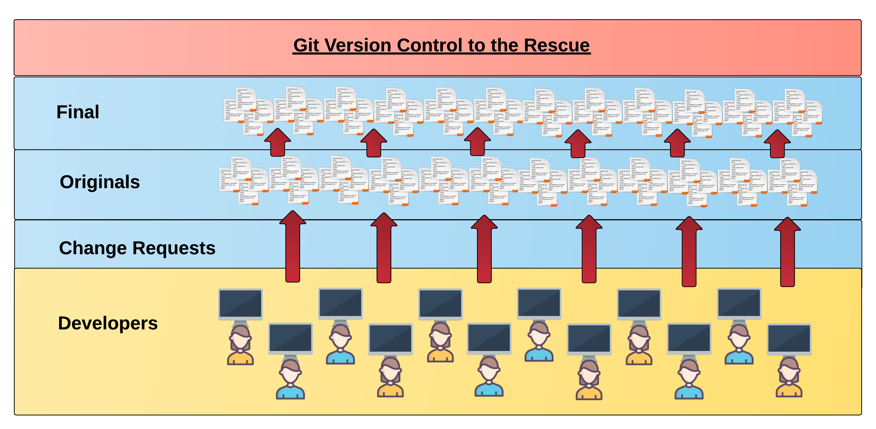
Collaborative Coding
Modern web development is highly collaborative.
Teams are often extremely large and separated across the country — or planet.
Apps sometimes comprise hundreds or even thousands of files.

Slide 11
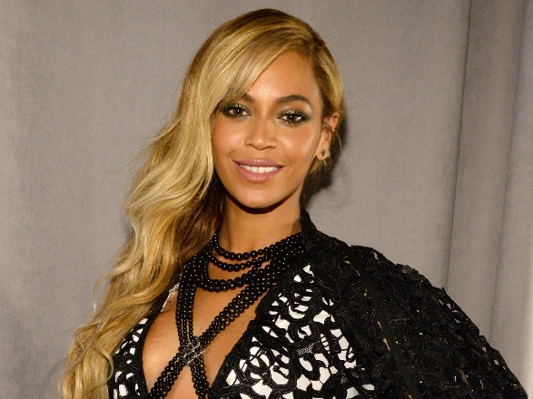


The Group Project - The Team’s Task
TASK Make a list of creative works you’ve written in the past
Programming Team
Beyonce Knowles
Chris Martin
Bruno Mars

Slide 12

Beyonce & Bruno make their edits
Programming Away…
Beyonce’s Version
Programming Away…
Bruno’s Version

Slide 13
Different Solutions
<ul>
<li>Bills, Bills, Bills</li> <li>Crazy In Love</li> <li>Ring the Alarm</li>
</ul>
<ul>
<li>24K Magic</li> <li>Uptown Funk</li> <li>Versace on the Floor</li>
</ul>
Different

Slide 14
Resolution
<ul>
<li>Bills, Bills, Bills</li> <li>Crazy In Love</li> <li>Ring the Alarm</li>
</ul>
“Let’s settle on this…”
<ul>
<li>Love Songs</li> <li>Sad Songs</li> <li>Dance Songs</li>
</ul>
<ul>
<li>24K Magic</li> <li>Uptown Funk</li> <li>Versace on the Floor</li>
</ul>

Slide 15
Chris writes his own stuff…
<ul>
<li>Adventure of a Lifetime</li> <li>Paradise</li> <li>Gravity</li>
</ul>

Slide 16

Chris overwrites work of his teammates…
Delete. Delete. Delete. Delete.
Delete. Delete
<ul>
<li>Love Songs</li> <li>Sad Songs</li> <li>Dance Mixes</li>
</ul>
<ul>
<li>Adventure of a Lifetime</li> <li>Paradise</li> <li>Gravity</li>
</ul>

Slide 17


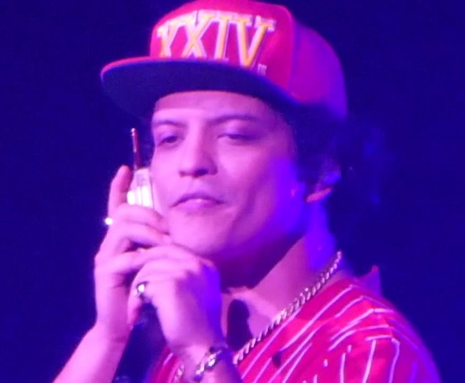
The Group Project
Lesson:
You should have put a ring on it used Version Control
….and watch your teammates’ work

Slide 18
Version Control
Git Version Control: Provides a organized system for managing code for when multiple developers work on a project
at the same time.
The Benefits of Git:
A process for resolving conflicts in code.
Version History.

Slide 19
The Group Project
Master Branch
‘Branch’ = personal copy
Personal branch
Beyonce’s branch
Chris’s branch
Bruno’s branch
Notes:
Let’s see what would have happened if our team was using Source Control

Slide 20
The Group Project - The team goes to work
<ul>
<li>Bills, Bills, Bills</li> <li>Crazy In Love</li> <li>Ring the Alarm</li>
</ul>
<ul>
<li>24K Magic</li> <li>Uptown Funk</li> <li>Versace on the Floor</li>
</ul>

Slide 21

The Group Project - Beyonce Pushes First
Master Copy
1
Beyonce pushes (uploads) her code changes into the main branch.
No code conflicts.
Beyonce’s Branch
Notes:
Check… everything is right in the world.

Slide 22
The Group Project - Bruno’s edits are ready
Rule: pull first… then push your changes
Ok

Slide 23
The Group Project - Bruno pulls latest changes
Master Copy
1
Bruno’s Branch

Slide 24
The Group Project - Bruno conflicts with master branch
Master Branch
1
<li>Bills, Bills, Bills</li> <li>Crazy In Love</li> <li>Ring the Alarm</li>
<li>24K Magic</li> <li>Uptown Funk</li> <li>Versace on the Floor</li>
Git sees a conflict.
Notes:
Git sees a conflict and is able to alert Bruno of the issue.

Slide 25
The Group Project - Bruno resolves
<ul>
<li>Love Songs</li> <li>Sad Songs</li> <li>Dance Songs</li>
</ul>
<li>Bills, Bills, Bills</li> <li>Crazy In Love</li> <li>Ring the Alarm</li>
<li>24K Magic</li> <li>Uptown Funk</li> <li>Versace on the Floor</li>
Bruno’s Branch

Slide 26
The Group Project - Bruno fixes and pushes
Master Branch
1
2
Bruno pushes (uploads) his revision the main branch.
No code conflicts.
<ul>
<li>Love Songs</li> <li>Sad Songs</li> <li>Dance Songs</li>
</ul>
Bruno’s Branch
Notes:
The master branch is now creating version history.
The first version included Beyonces changes. The second version includes Bruno’s changes
No code conflicts, everything is great.

Slide 27
The Group Project - Chris starts his work
Rule: pull first, then push your changes

Slide 28
The Group Project - Chris pushes
Master Branch
1
2
3
Chris pushes (uploads) his revision the main branch. No code conflicts.
Not what we want.
<ul>
<li>Adventure of a Lifetime</li> <li>Paradise</li> <li>Gravity</li>
</ul>
Chris’s Branch
Notes:
Can ??? Tell me what Chris should have done before pushing his code to the main branch?

Slide 29
The Group Project - If Chris had made a pull first…
Conflict!
<ul>
<li>Adventure of a Lifetime</li> <li>Paradise</li> <li>Gravity</li>
</ul>
<ul>
<li>Love Songs</li> <li>Sad Songs</li> <li>Dance Mixes</li>
</ul>

Slide 30
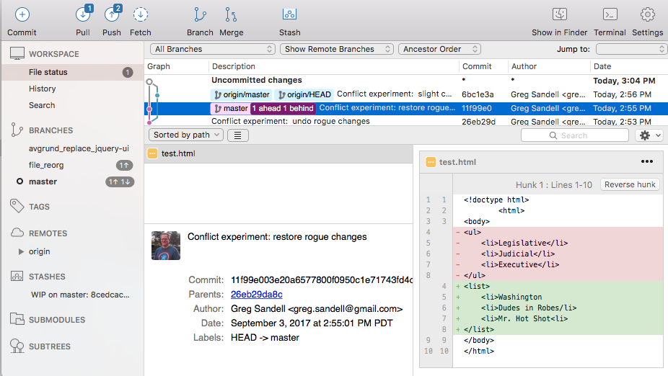

The Group Project - The overwritten work is discovered

Slide 31
The Group Project - Roll Back
Main Branch
1
2
3
4
Beyonce rolls back the code to an earlier version.
Chris’s Branch

Slide 32
The Group Project
Lesson:
You should use Version Control!

Slide 33
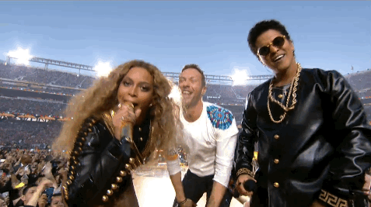
The Group Project

Slide 34
Quick Activity!
Suggested Time: 3 min
Turn to your neighbor, and have one of you explain to the other:
The concept of version control.
Then the other should explain:
Two of the key advantages to using a version control system.

Slide 35

Questions
Notes:
Classroom Discussion: Ask 2 students the advantage of using Git

Slide 36

So… What’s this GitHub?
GitHub is a Web-Based hosting service to store code online.
It allows developers to pull (download) code or push (upload) code to the same repository (directory).
It also allows developers to view histories of code changes and to track issues.
Notes:
Git is a tool to help you manage code. GitHub is one of the many websites used to manage Git repositories. We are using GitLab for our class.

Slide 37




Pushing and Pulling to GitHub
1
2
3
4
GitHub Branch
Pull Code
Push Code
Pull Code
Pull Code
Push Code
Pull Code
Push Code
Notes:
Let’s look at our team project using GitHub. Beyonce and Chris pull version 1. Beyonce pushes and creates version 2.
Every change becomes a new version. You can’t go back and change an old version.
What does it mean to pull code?
What does it mean to push code?

Slide 38
Get Started with Git

Slide 39
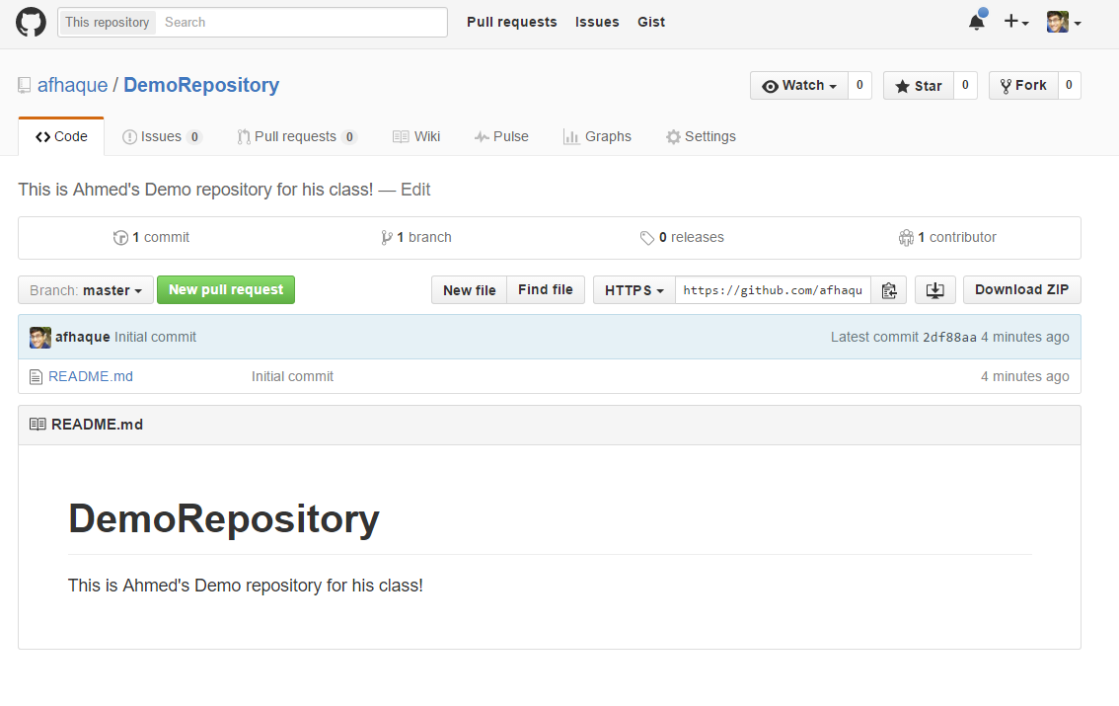
Instructor Git Demo!

Slide 40
Basic Git Commands
At its most basic, these are the five git commands to get started:
git clone
git add
git commit
git push
git pull
Notes:
Let’s go over the commands. Pick persons to answer each.

Slide 41
Basic Git Commands
At its most basic, these are the five git commands to get started:
git clone – copies an entire repo (to begin).
git add – adds a file for inclusion in Git.
git commit – notes a change to the local repo.
git push – sends changes to hosting service.
git pull – downloads freshest version of repo.

Slide 42
YOUR TURN!
Activity: Git Add, Commit, Push | Suggested Time: 20 min
Assignment:
Using GitHub and the Command Line:
Create a new public GitHub repository and name it whatever you like. Be sure to check the box for “initialize this repository with a README.”
Next, clone the repo to your local directory.
Then create an HTML file inside the local directory.
Add, Commit, and Push the code to GitHub.
Bonus:
Find a partner in class, and fork their repository to your own GitHub account. Clone this forked repository to your local directory.
Add, Commit, and Push the code back to your forked copy.
Finally, submit a pull request to send your changes to your partner’s repo.

Slide 43

Still a Bit Lost? Never Worry!
Follow this handy Guide!
Practice a few times on your own before our next class.
Notes:
Review the youtube video that will be handed out after class.

Slide 44
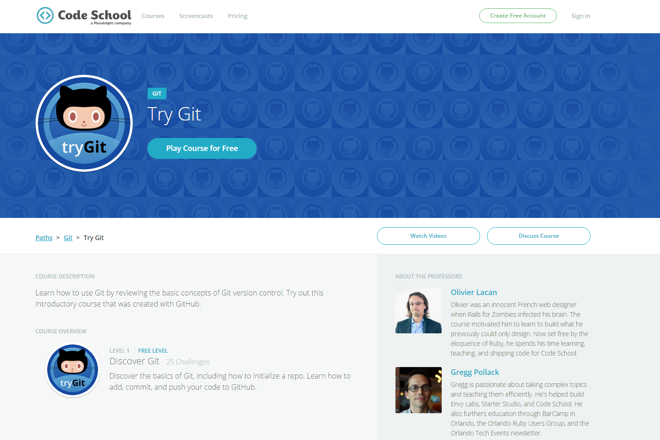
If You’re Still Lost… Here’s a (Free) Course
https://www.codeschool.com/courses/try-git

Slide 45
HTML Round 2

Slide 46
HTML Syntax (Basic)
Content
<h1>
This is Mah House
</h1>
Opening Tag
Closing Tag
Notes:
Ask ??? To briefly explain what we are looking at.
Sometimes the content can be more html

Slide 47
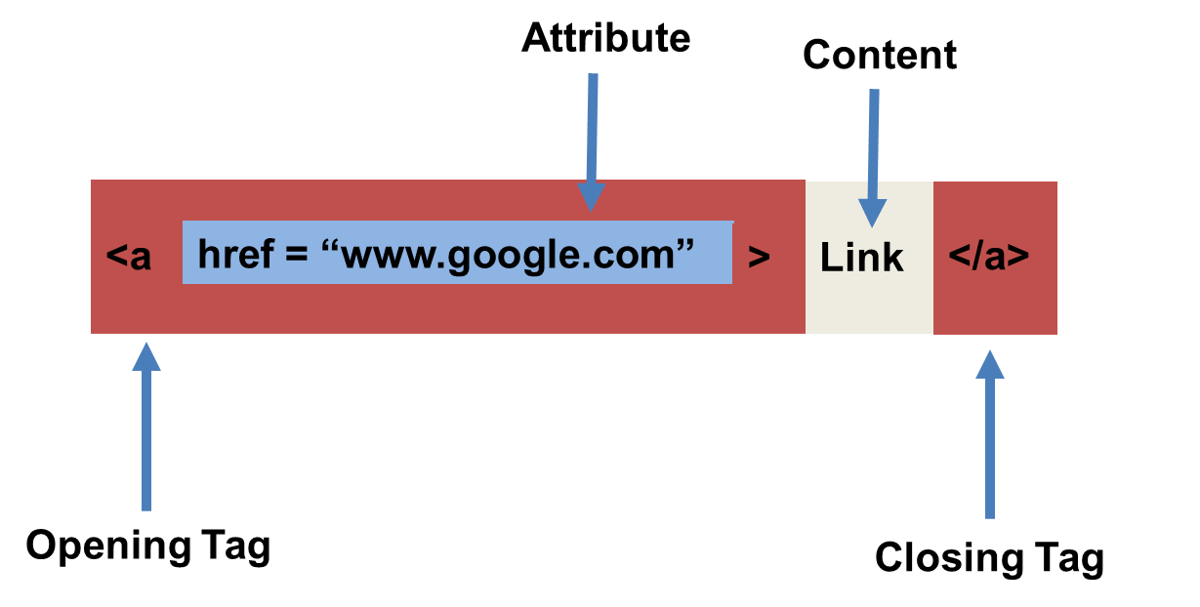
HTML Syntax (with Attribute)
HTML Element
Notes:
??? What does href stand for? Hyperlink reference
Most of the time attributes are optional. Exception image.

Slide 48
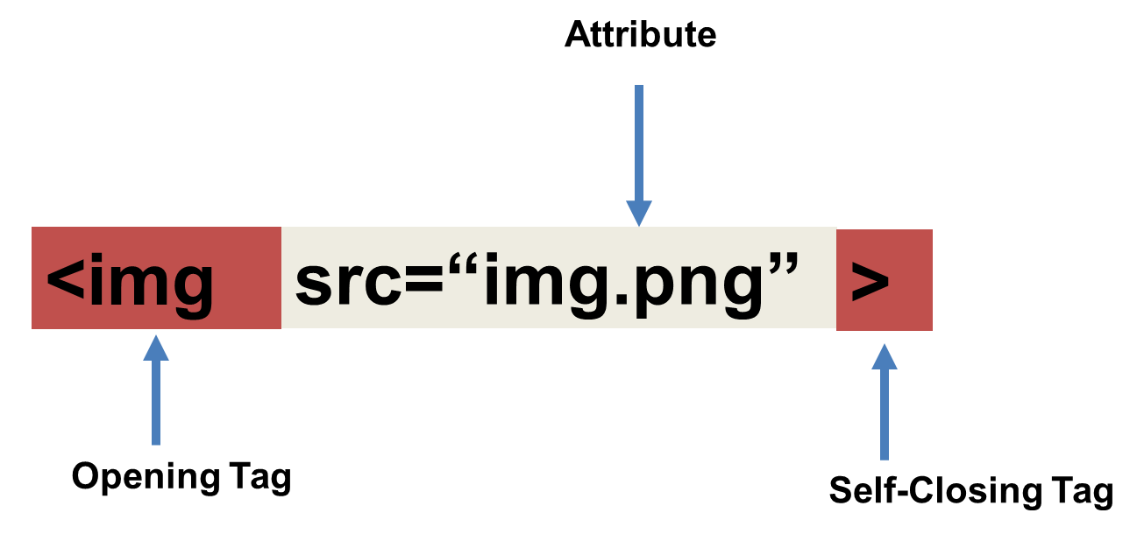
Tricky Tags (Self-Closing)
<img src=“img.png” />
Notes:
Image tag requires an attribute. The image source is the content so it can self-close.
I like to close tags anyway… just to keep it consistent.
Are there any other tags that are self-closing (<br>,<hr>)

Slide 49
Important Common Tags
Headings:
<h1> </h1> - Heading 1 (Largest Heading)
<h2> </h2> - Heading 2 (Next Largest Heading)
<h3> </h3> - Heading 3
…
Containers:
<html> </html> - Wraps the entire page
<head> </head> - Wraps the header of the page
<body> </body> - Wraps the main content
<div> </div> - Logical Container ***
<p> </p> - Wraps individual Paragraphs
Others:
<strong> (bold), <em> (emphasis)
<img> (images), <a href> (links), <li> (list items) , <title> (title), <br> (line break), <table> (tables), <!-- --> (comments)
Notes:
Using tags makes your content easier to find by search engines

Slide 50
Less Common Tags
All HTML Tags are listed here: http://www.w3schools.com/tags/
Don’t try to memorize them! Simply refer back to documentation as needed.
Other tags:
<video> for Videos
<audio> for Audio files
<embed> for Embedded files
<code> for including computer code
<header> for headers
<nav> for navigation bars
<footer> for footers

Slide 51
HTML for Forms
Common UI (User Interface) Form Elements:
<form> - Creates a form section in HTML
<input> - Input boxes
<label> - Labels for boxes
<button> - Button
<textarea> - Large textbox

Slide 52
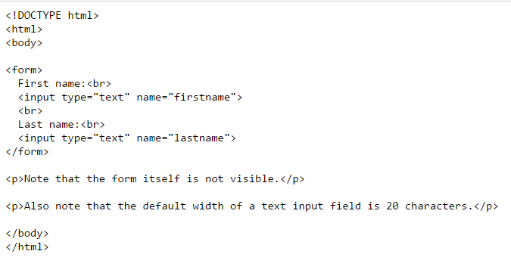
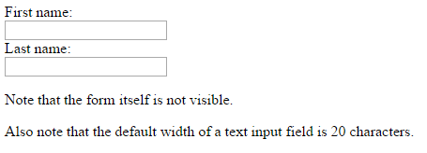
HTML for Forms

Slide 53
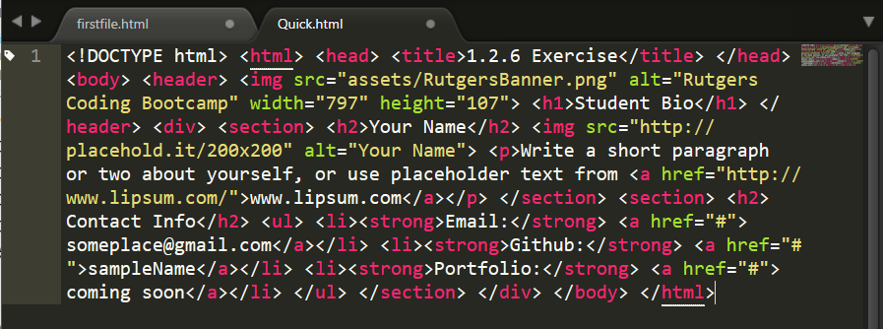
On Ugly HTML
Don’t do this… Use proper indentation and sectioning.
Readable code is easier to maintain.
Invest time to get better about this now. It will pay dividends!
Notes:
If you have all of your code on one line… it’s harder to?

Slide 54
YOUR TURN!
Activity: 1-HTML_Git | Suggested Time: 20 min
Assignment
In this activity, you’ll create a student bio using HTML. You will then add, commit, and push your completed HTML to GitHub for the world to see.
Additional instructions, sent via Slack.
Notes:
If you already have a GitHub that works… just keep using it.

Slide 55
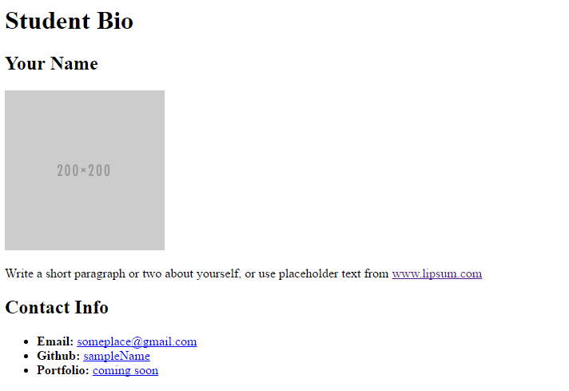
YOUR TURN!

Slide 56

Break…

Slide 57
CSS Stylin’

Slide 58


HTML / CSS Definitions (*yawn* unimportant)
HTML: Hypertext Markup Language – (Content)
CSS: Cascading Style Sheets – (Appearance)
HTML/CSS are the “languages of the web.” Together they define both the content and the aesthetics of a webpage – handling everything from the layouts, colors, fonts and content placement.
(JavaScript is the third – handling logic, animation, etc.)
Notes:
What does HTML stand for?
3 primary languages of the web

Slide 59


HTML / CSS Analogy
HTML Alone
Like writing papers in “Notepad.”
Can only write unformatted text.
HTML / CSS
Like writing papers in Microsoft Word.
Can format text, page settings, alignment, etc. based on “highlighting” and menu options.

Slide 60
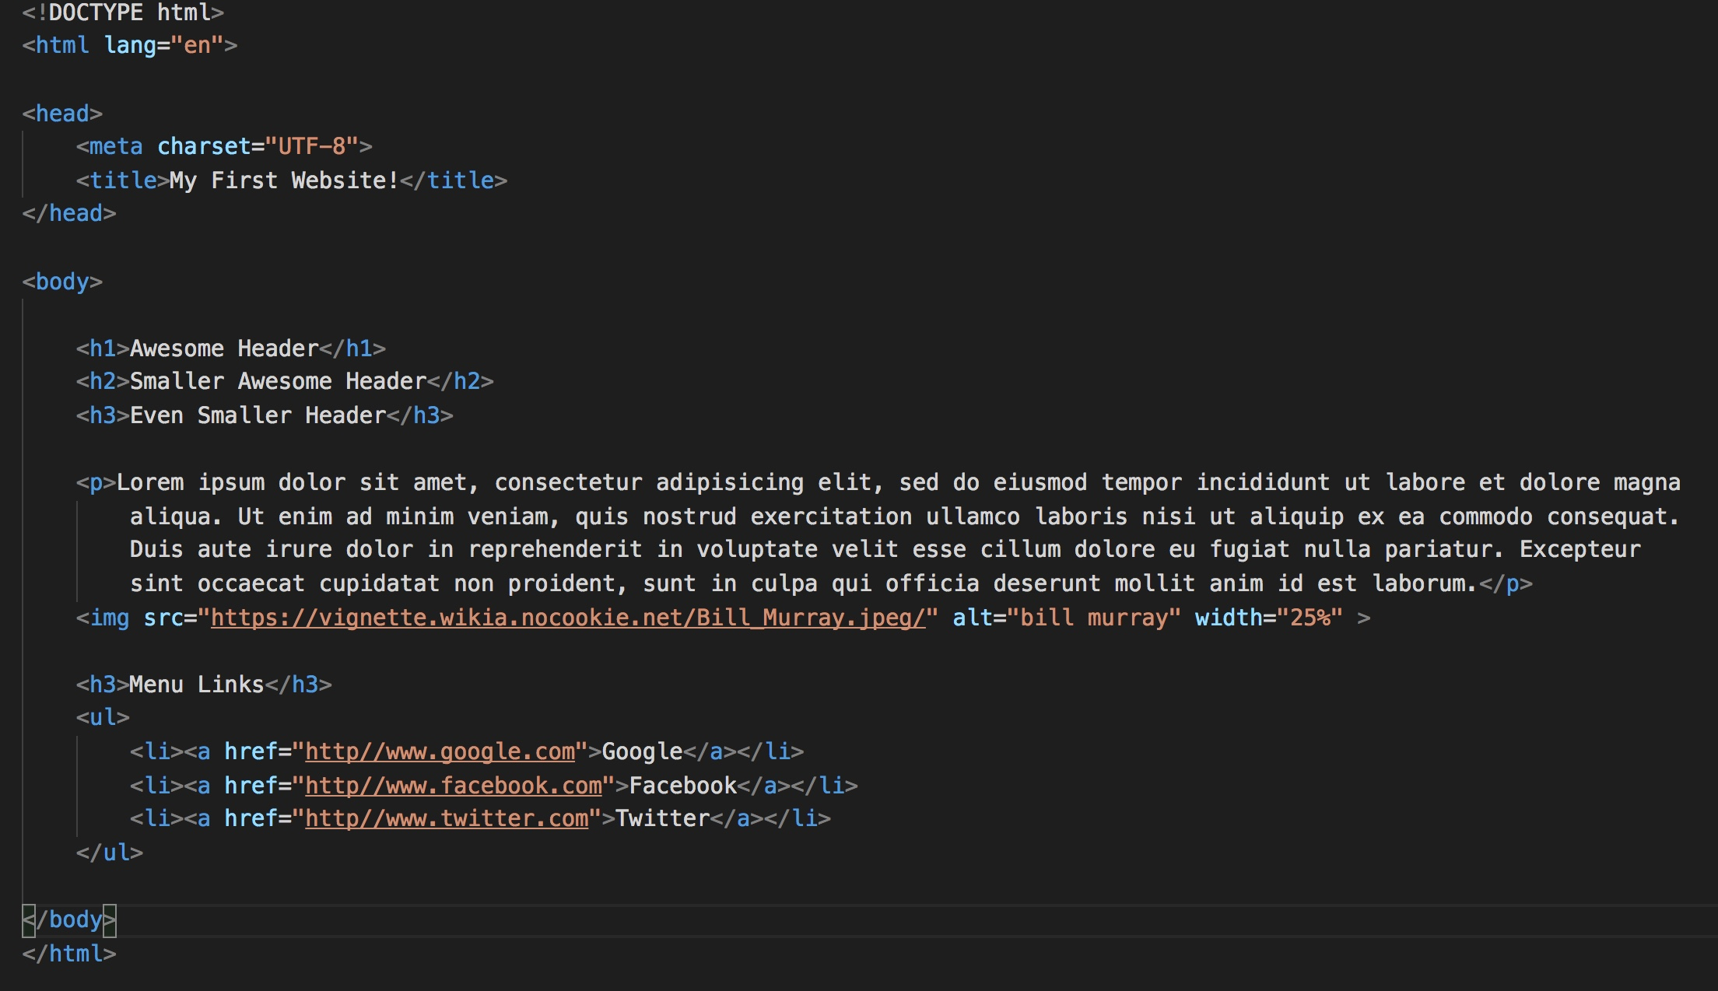
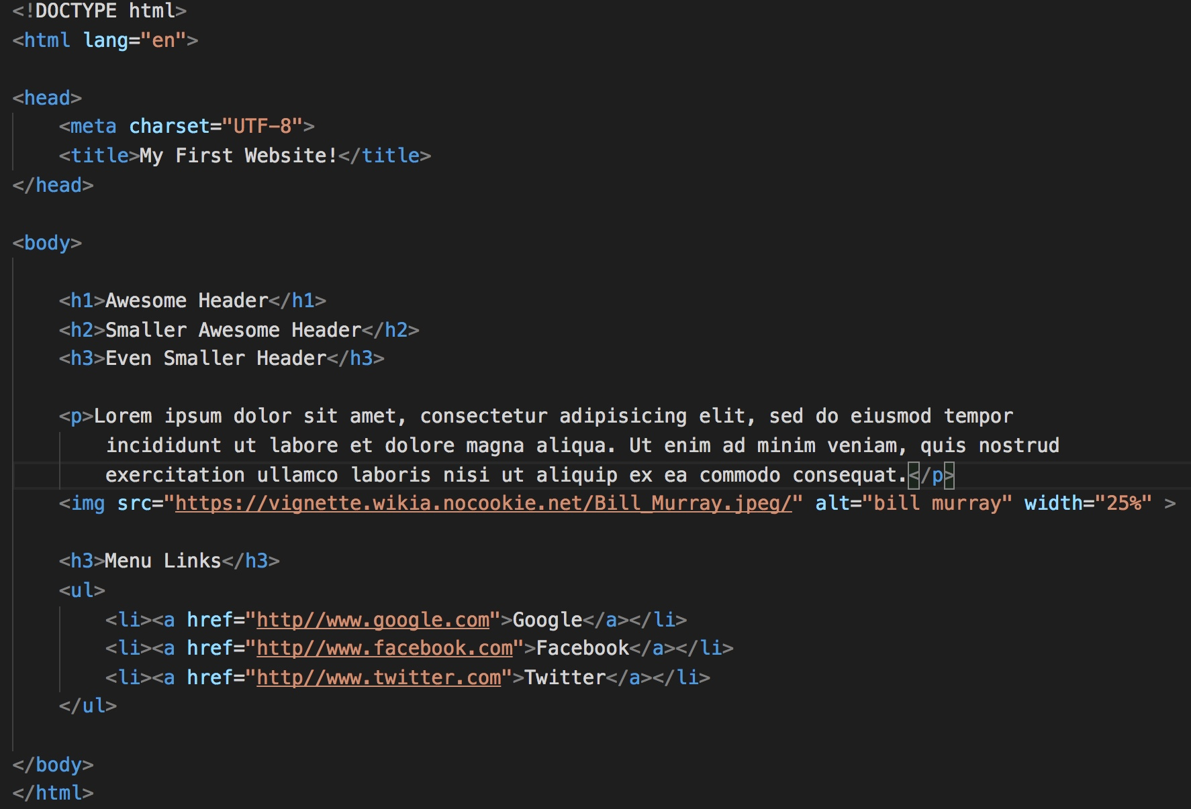
Basic HTML Page

Slide 61

Basic HTML Page - Result

Slide 62
Basic HTML Page - Result
Hella Boring…

Slide 63
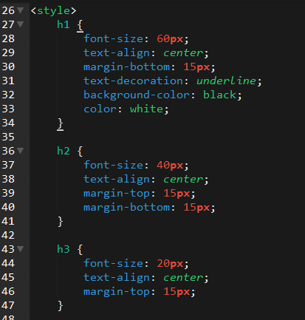
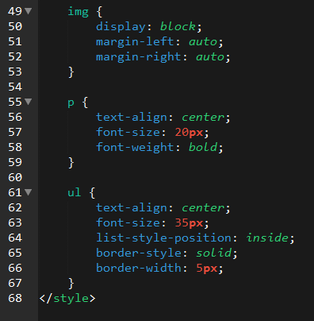
Enter CSS
Notes:
You are able to style all elements on the page using CSS. You can define things such as font-size, margins, colors, etc.
This becomes extremely important, especially, when you need to change all elements of a website.

Slide 64

Enter CSS - Result
Notes:
The result is a web page with a more refined look and feel. While still ugly… it has more style than it did before.
Color, borders, alignment, fonts

Slide 65

CSS Syntax
CSS works by hooking onto selectors added into HTML using classes and identifiers.
Once hooked, we apply styles to those HTML elements using CSS.
Notes:
This example CSS statement, is basically saying that all html links should have a background color of yellow.
Curly brace

Slide 66
CSS Example
In the below example the “Header” would be turned blue and MUCH larger because of the CSS.
We can incorporate an element’s class or ID to apply a CSS style to a particular part of the document.
Just remember to include the necessary symbol before the CSS: “.” for class, “#” for ID.
Example (HTML):
<p class=“bigBlue”>Header</p>
Example (CSS):
.bigBlue
{
font-size: 100px;
color: blue;
}
Notes:
. (dot) denotes a class
# (hash tag) denotes a id
If this is too confusing… just use selectors

Slide 67
Key CSS Attributes
Font / Color:
color: Sets color of text.
font-size: Sets size of the font.
font-style: Sets italics.
font-weight: Sets bold.
Alignment / Spacing:
padding (top/right/bottom/left): Adds space between element and its own border.
margin (top/right/bottom/left): Adds space between element and surrounding elements.
float: Forces elements to the sides, centers, or tops.
Background:
background-color: sets background color.
background-image: sets background image.

Slide 68
Powerful Duo
Believe it or not, HTML / CSS is all you need
to develop a vivid, full-blown website.

Slide 69
INSTRUCTOR DEMO
Instructor: Demo
(quickexample_internalcss.html | 2-BasicCSS)

Slide 70
YOUR TURN!
Activity: 3-HTML_CSS_Layout | Suggested Time: 20 min
Assignment
In this activity, you’ll upgrade your previous HTML bio-page using CSS style rules. Once you’re done, commit and push up your changes to GitHub.
We’ll send you additional instructions via Slack.

Slide 71
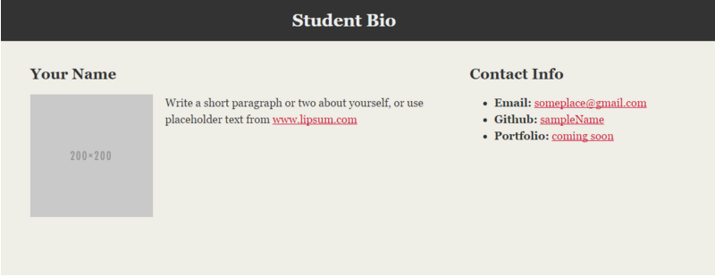
> YOUR TURN!

Slide 72
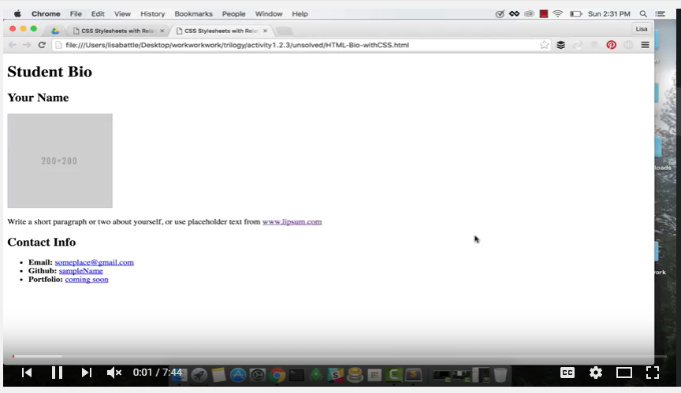
Video Walkthrough!!
8 min
https://www.youtube.com/watch?v=kMBinXTCrXI&list=PLgJ8UgkiorCnMLsUevoQRxH8t9bt7ne14&index=2

Slide 73

Still a Bit Confused?
Remember! We’ve got video guides for key activities like that last one.
If you feel like you are EVER falling behind, use those online walkthroughs to help catch back up. They are made to be easy to understand.
Still having trouble? Shoot your instructor or one of your TAs a message!
We are here to help you out in whatever way we can!

Slide 74
Recap + Questions

